Slide 1
Introducing New Market Offerings
Chintan S. Jikkar
Notes:
Hello everyone, my name is Chintan Jikkar, and today I’ll be presenting a summary of Chapter 15 from Marketing Management. This chapter dives into how companies develop and bring new products to market by understanding both the creation process and consumer adoption.
{Now, can anyone think of a new product they use regularly that wasn’t around 10 years ago?”
Don't answer, it’s a rhetorical question! But we all know if we did start listing, we could go through the whole lecture and still have things to add to the list.}

Slide 2
Table of contents
Consumer Adoption Process
Types of New Products
01
02
New Product Development Process
Product Life Cycle
03
04
Notes:
So, before we start here’s a quick overview of what we’ll cover during this chapter’s review.

Slide 3
Why!
Notes:
We’ll begin by discussing WHY! companies develop new products in the first place. Innovation helps companies stay competitive, meet changing consumer needs, and enter new markets. New products also generate revenue, build brand loyalty, and can transform industries, as we saw with the smartphone.

Slide 4
01
Types of New Products
Notes:
Let’s start with the three different types of new products companies introduce to meet various market needs:

Slide 5

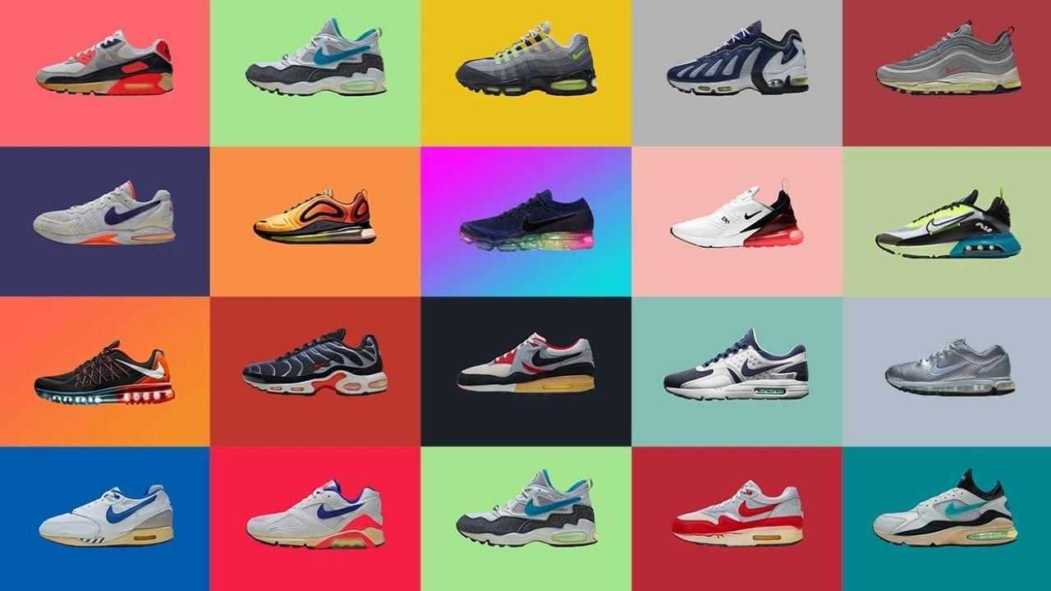
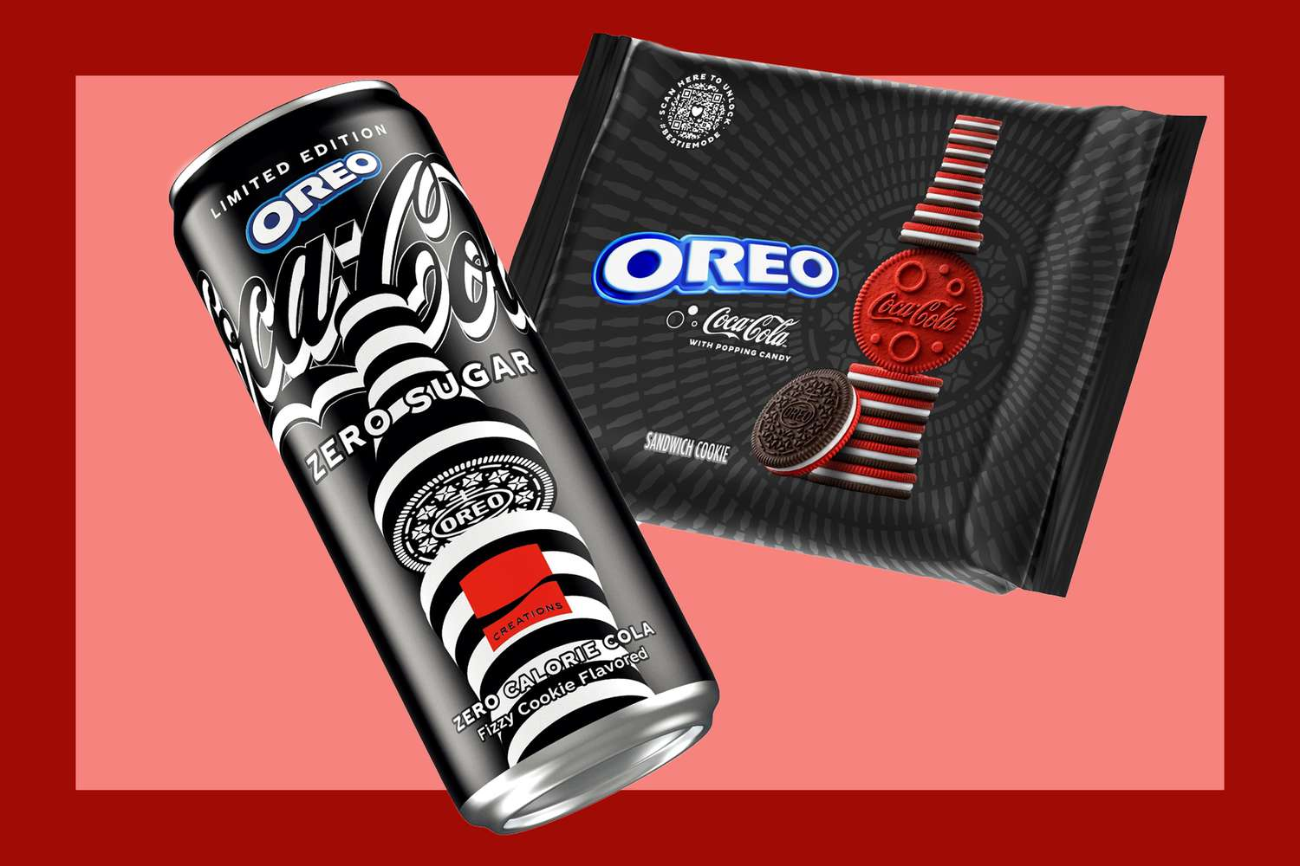
Types of New Products
Major Innovations
Minor Modifications
Product Line Extensions
(create new markets)
(improvements to existing products)
(new flavors or models)
Notes:
First are Major Innovations these are the big breakthroughs, like the launch of the first smartphone or the electric vehicle. Major innovations create entirely new markets or dramatically change existing ones, often driving huge shifts in consumer behavior.
A good Example is the Tesla Model S
Then comes Minor Modifications these are small but important improvements to existing products, like a new camera on a smartphone or the annual car model updates. Minor modifications aren’t revolutionary, but they keep the product competitive and appealing, giving consumers a reason to upgrade or stay loyal. Afterall these changes are typically in response to consumer feedback or minor technological advancements.
Example: Nike releasing updated versions of the Air Max/Jordan series every year.
Lastly Product Line Extensions adds variety within an existing product line, like new flavors, colors, or sizes. These extensions help reach different consumer segments without developing an entirely new product.
Example: Oreo launching its newest creation in collaboration with Coca Cola is a good example.
Each type varies in risk and market impact, so understanding these distinctions helps in planning the right approach.

Slide 6
Understanding the Market
Cojoint Analysis
Scenario Planning
Helps prioritize features consumers want.
Prepares companies for market changes.
Notes:
Now that we’ve covered the types of new products, let’s look at how companies figure out what consumers actually want. This is a critical part of ensuring a product’s success. Two main tools help companies do this:
Conjoint Analysis is a method used to understand which features matter most to consumers. By focusing on these insights, companies can make sure they’re delivering what consumers value most.
An electronics company might use conjoint analysis to determine if customers prioritize battery life, camera quality, or screen size in a new smartphone model. Results help the company design a product aligned with customer preferences.
On the other hand Scenario Planning is all about preparing for possible changes in the market by modeling different future scenarios. Companies can plan for different ‘what if’ situations, like an economic downturn or a sudden trend shift. By preparing for these possibilities, they can adapt quickly, keeping their products relevant no matter what happens.
An energy company might develop scenarios for different regulatory landscapes and shifts toward renewable energy. These scenarios help them prepare for potential changes in policy and market demands.
These insights guide the product’s design, positioning, and even its target audience. With this groundwork, the next step is understanding how consumers actually adopt new products.

Slide 7
Consumer Adoption Process
02
Notes:
The adoption process is like a journey, with five stages that moves from Awareness to Adoption:

Slide 8
Consumer Adoption Process
Awarness
Interest
Evaluation
Trial
Adoption
Consumers hear about the product.
They seek more information.
They assess if the product fits their needs.
Trying the product on a small scale.
They make full commitment.
Notes:
Awareness comes when the consumers first learn about the product. They might see an ad, hear about it from a friend, or spot it online.
Since I'm an Apple fanboy I will use the Apple Watch as an example to better explain this process. When the Apple Watch was first announced, consumers saw ads, press releases, and news stories that built initial awareness of the product.
Interest Once they’re aware, they start becoming curious. They might research online, watch reviews, or visit a store to check it out.
After learning about the Apple Watch, people who were interested in wearable tech might become curious and research its features, check reviews, or visit an Apple Store to see it firsthand.
Evaluation is when the consumers weigh whether the product is right for them. They might compare it to alternatives or ask themselves, ‘Does this fit my needs?’
Potential Apple Watch buyers might weigh its fitness tracking features and seamless integration with other Apple devices against the price and ask themselves "Does this fit my needs?".
Trial: If they’re convinced, they give the product a try. This could be a free in-store trial, a test drive, or just exploring it more deeply to get a feel for it.
Apple sometimes offers the Apple Watch for trial in-store or allows a return period after purchase. This lets consumers try out the watch’s functions and see if they like using it day-to-day.
Adoption: Finally, if they’re satisfied, they make a commitment and start using the product regularly.
A consumer finally the consumer buys the Apple Watch, uses it regularly to monitor health and receive notifications, and perhaps even buys accessories for it, making it a part of their daily life.
Factors like relative advantage, simplicity, and compatibility influence adoption. Companies use this knowledge to address consumer concerns and support each stage of the journey.

Slide 9
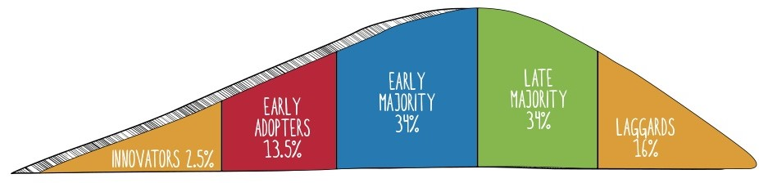
Adopter Categories
Risk-takers
Opinion leaders
Practical
Skeptics
Last to adopt
Notes:
Consumers don’t all adopt new products at the same pace; they’re divided into five adopter categories based on when they’re likely to try something new:
Innovators: are the risk-takers, the first to try anything new, even if it’s experimental. They’re often passionate about technology or innovation and enjoy being the first.
Early Adopters: aka trendsetters, are influential opinion leaders in their social circles. They help products gain credibility and encourage others to try them too.
Early Majority: are more practical and wait to adopt until the results prove that the product works well.
Late Majority: adopts a product only once it’s widely accepted and proven and are more skeptical and cautious.
Laggards: are the last to adopt, often sticking with familiar products unless they’re left with no choice.
By understanding these categories, marketers can tailor strategies to appeal to each group, encouraging widespread adoption and credibility.

Slide 10
03
New Product Development Process
Notes:
To reduce risks, Kotler & Keller outline an eight-stage new product development process that a company goes through to bring a product to life:

Slide 11
Idea Screening
Business Analysis
Market testing
2
4
6
1
3
5
7
Idea Generation
Concept Development & Testing
Product Development
Commercialization
Notes:
Starting with Idea Generation: this is the brainstorming phase, where companies gather ideas from employees, customers feedback, and emerging market trends.
Then comes Idea Screening: This is where companies filter ideas to focus only on those with the most potential and alignment with company goals, so as to avoid unnecessary costs on weak ideas.
In Concept Development & Testing: phase, they create a basic version and test it with real customers to gather feedback.
At Business Analysis: stage, the company assesses costs, revenue projections, and overall financial viability to decide if it’s worth pursuing.
Product Development: is when they create a working prototype and finalize the design. This step takes considerable time and resources, especially for complex products.
Before making a full launch Market Testing is performed, the product is introduced in select-controlled areas, where they gauge the customers' reaction and fine-tune the final details.
Finally in Commercialization, the product is launched on a larger scale to the entire market with full marketing support, implementing full-scale production and distribution.
Each stage is essential as it builds on the previous one to minimize risks and ensure the product aligns with what consumers need.

Slide 12
Product Life Cycle
04
Notes:
Once launched, a product goes through a predictable life cycle what is known as the Product Life Cycle (PLC), which helps companies manage products profitable and relevance at different stages:

Slide 13
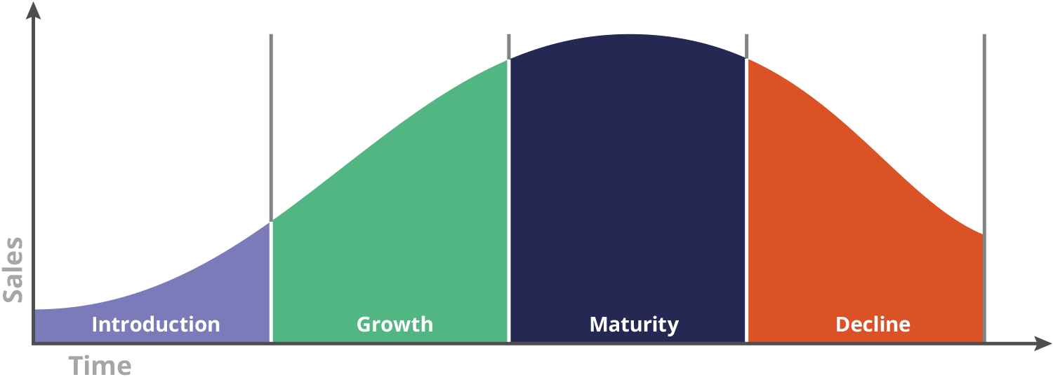
Compete and Differentiate
Build awareness
Increase Market Share
Phase out or reposition
Notes:
Let’s start with the launch phase. In this stage, the primary goal is to build awareness and encourage initial trials. Companies often invest heavily in marketing, but this can result in low sales and negative profits due to high promotion costs.
A great example of this is Apple’s introduction of the iPod in 2001. It was a groundbreaking product in the personal music player market, promising users the ability to carry "1,000 songs in their pocket." Initially, sales were slow, as many consumers were unfamiliar with digital music players. Apple targeted early adopters, highlighting the iPod’s unique design and usability to generate excitement and awareness.
Next is the growth phase. As sales began to increase, more consumers became aware of and adopted the iPod. Companies expanded their distribution and introduced new features to stay competitive.
With rising popularity, the iPod’s sales surged. Apple capitalized on this momentum by releasing improved versions, such as the iPod Mini and iPod Nano, to appeal to a broader audience. Competitors like Microsoft and Sony entered the market with similar products. Apple’s marketing campaigns, particularly the iconic "Silhouettes" ads, emphasized the iPod’s sleek style and ease of use, helping it capture a significant share of the expanding market.
By the mid-2000s, the iPod entered the maturity phase. While sales remained high, growth began to slow as the market became saturated, with many consumers already owning a digital music player.
To maintain interest, Apple continued to innovate, introducing models like the iPod Touch, which featured Wi-Fi and app capabilities. However, as smartphones with built-in music players, particularly the iPhone, grew in popularity, Apple faced the challenge of differentiating the iPod to keep it appealing.
Finally, we reach the decline phase. Eventually, the iPod entered this stage, driven by shifting consumer preferences toward smartphones. As demand for standalone music players decreased, Apple began to scale back its focus on the iPod, reducing new model releases and marketing efforts. By 2022, Apple officially discontinued the iPod, acknowledging that demand had waned as streaming services and smartphones dominated the market.
Each phase requires different strategies to maintain profitability and manage product longevity.

Slide 14
Thank You!
Notes:
Thank you for listening—I hope this gave you a clear view of how new products come to life in the market!

